Slide 1
Group 16: Kalvin Goode,

Slide 2
Content
Introduction
Dataset
Analysis
Prediction
Conclusion

Slide 3
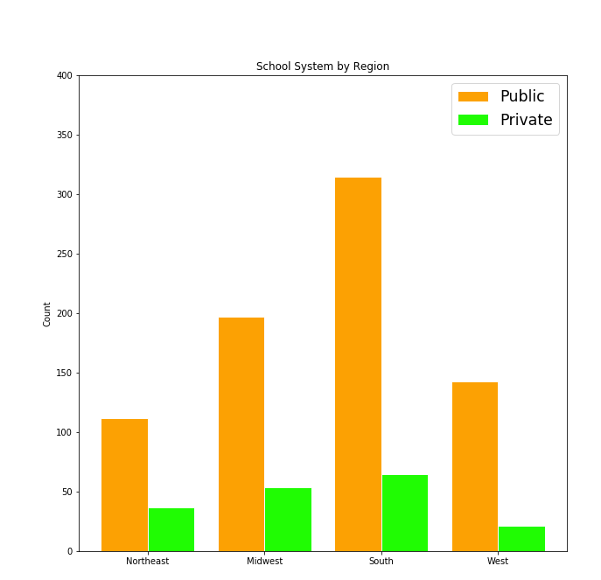
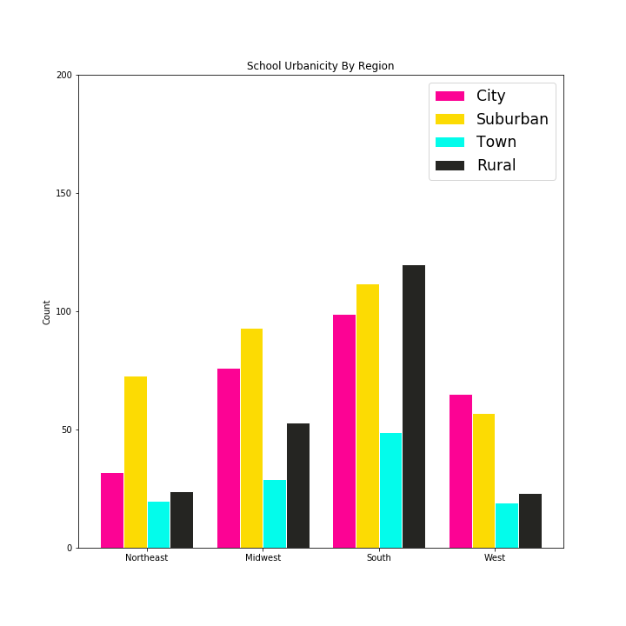
School Distribution in data
Northeast: 15.8%, Midwest: 26.6%, South: 40%, West: 17.3% from 944 schools
Public School accounts for 80% of the survey data

Slide 4
